Slide 1
MANAGEMENT OF THE THIRD STAGE OF LABOUR
FIRM FOUR
Supervisor Dr. Wangwe

Slide 2
DEFINITION
The third stage of labor commences with the completed delivery of the fetus and ends with the completed delivery of the placenta and its attached membranes.

Slide 3
PHYSIOLOGY
Over the course of a pregnancy, maternal blood volume increases by approximately 50%, from 4 to 6 L.
increase in blood volume serves to fulfill
  the perfusion demands of the low-resistance uteroplacental unit and
  to provide a reserve for the blood loss that occurs at delivery.
  also protects against hypotension caused by decreased venous return and
  decreased vascular tone due to high progesterone levels

Slide 4
PHY cont………..
Changes also occur in the coagulation system, with a marked increase in clotting factors and a decrease in fibrinolytic activity
Although uterine contraction is initially responsible for controlling blood loss at the placental site, clot formation and fibrin deposition occur rapidly and are essential in maintaining hemostasis and promoting involution in the days following delivery

Slide 5
Early in pregnancy, the uterus grows dramatically, from an initial weight of roughly 70 g and a cavity volume of 10 mL to a term weight of 1.1 kg and a capacity of approximately 5 L
increase in blood flow to the uterus during pregnancy. At term, the estimated blood flow to the uterus is 500-800 mL/min, which represents 10-15% of cardiac output

Slide 6
Following delivery of the fetus, uterine contractions continue and the placenta is sheared from the underlying endometrium
This separation primarily occurs by a reduction in the surface area of the placental site as the uterus shrinks. This decrease is caused by myometrial retraction, which is a unique characteristic of the uterine muscle to maintain its shortened length following each successive contraction. In this way, the placenta is undermined, detached, and propelled into the lower uterine segment.

Slide 7
The second mechanism of separation is through hematoma formation due to venous occlusion and vascular rupture in the placental bed caused by uterine contractions. As the placenta detaches, the spiral arteries are exposed in the placental bed; massive hemorrhage would occur if not for the structure of uterus. The vessels supplying the placental bed traverse a latticework of crisscrossing muscle bundles that occlude and kink-off the vessels as they contract and retract following expulsion of the placenta. This arrangement of muscle bundles has been referred to as the "living ligatures" or "physiologic sutures" of the uterus

Slide 8
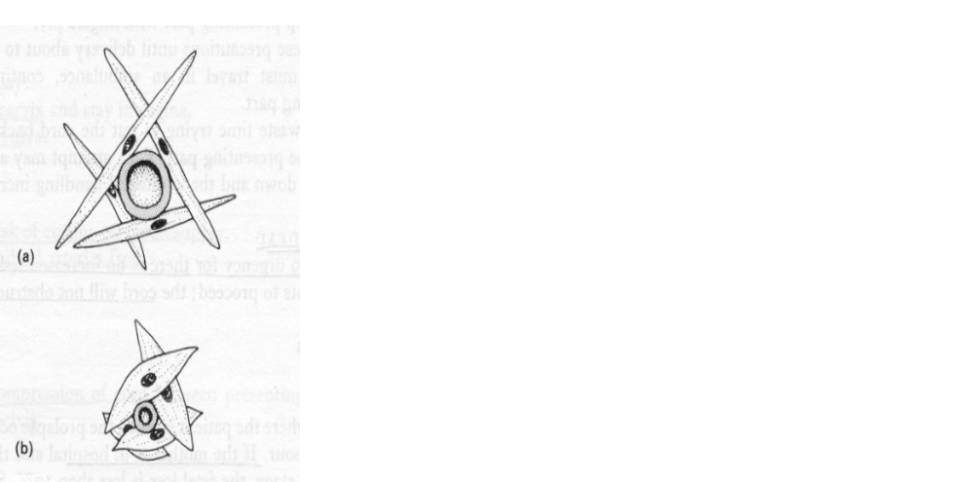

Haemostasis
Uterus contracts after delivery
This compresses vessels.
Reducing blood loss

Slide 9
CLINICAL ASPECT
All women who deliver are at risk of complications in the third stage of labor. These complications include PPH, retained placenta, uterine inversion.
placenta accreta and its variants). Remember that most complications of the third stage occur in low-risk women;

Slide 10
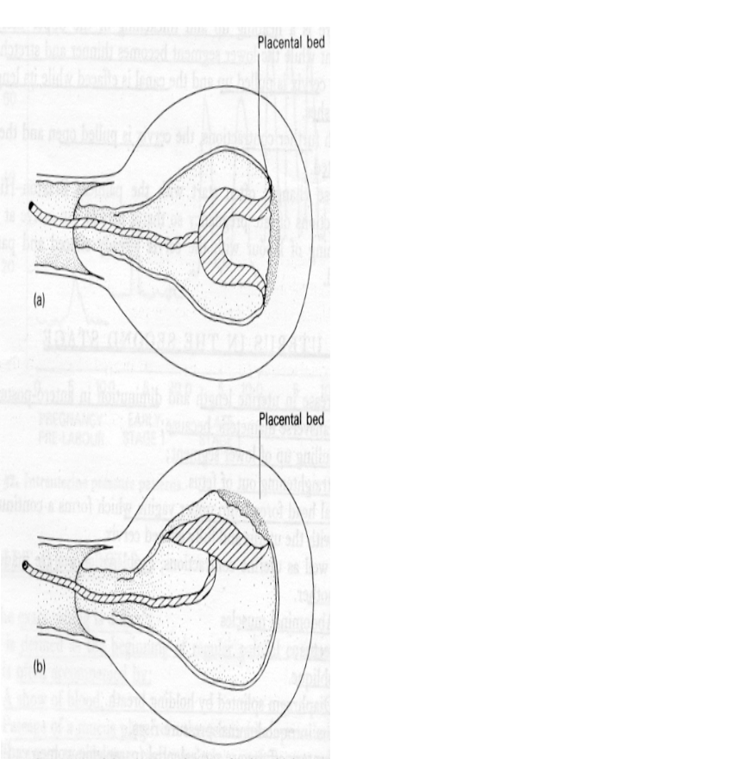
Signs of placental separation
4 signs of placental separation
lengthening of the umbilical cord as the placenta separates and is pushed into the lower uterine segment by progressive uterine retraction
The uterus takes on a more globular shape and becomes firmer. This occurs as the placenta descends into the lower segment and the body of the uterus continues to retract.

Slide 11
Sign cont…..
3 The uterus rises in the abdomen. The descent of the placenta into the lower segment, and finally into the vagina, displaces the uterus upward.
4 A gush of blood occurs.

Slide 12
MANAGEMENT OF THIRD STAGE OF LABOUR.
Active management of the third stage (active delivery of the placenta) helps prevent postpartum haemorrhage. Active management of the third stage of labour includes:
immediate oxytocin;
controlled cord traction; and
uterine massage.

Slide 13
Oxytocin
oxytocin is given soon after the deliver of anterior shoulder in single pregnancy.(5iu iv or 10iu IM)
Oxytocin is preferred because it is effective 2 to 3 minutes after injection, has minimal side effects and can be used in all women. If oxytocin is not available, give ergometrine 0.2 mg IM or prostaglandins. Make sure there is no additional baby(s) before giving these medications.
Do not give ergometrine to women with pre-eclampsia, eclampsia or high blood pressure because it increases the risk of convulsions and cerebrovascular accidents.

Slide 14
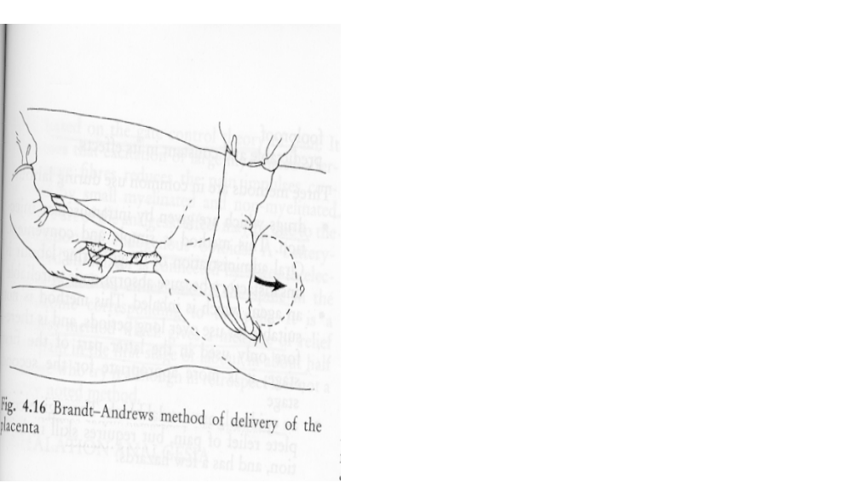
Controlled cord traction and massage the uterus
Clamp the cord
Hand placed suprapubically pushes up gently
Cord traction.
Gently massage the uterus

Slide 15
Controlled cord traction
Clamp the cord close to the perineum using sponge forceps. Hold the clamped cord and the end of forceps with one hand.
Place the other hand just above the woman’s pubic bone and stabilize the uterus by applying counter traction during controlled cord traction. This helps prevent inversion of the uterus.
Keep slight tension on the cord and await a strong uterine contraction (2–3 minutes).
When the uterus becomes rounded or the cord lengthens, very gently pull downward on the cord to deliver the placenta. Do not wait for a gush of blood before applying traction on the cord. Continue to apply counter traction to the uterus with the other hand.
If the placenta does not descend during 30–40 seconds of controlled cord traction (i.e. there are no signs of placental separation), do not continue to pull on the cord:

Slide 16
Never apply cord traction (pull) without applying counter traction (push) above the pubic bone with the other hand.
As the placenta delivers, the thin membranes can tear off. Hold the placenta in two hands and gently turn it until the membranes are twisted.
Slowly pull to complete the delivery.
If the membranes tear, gently examine the upper vagina and cervix wearing high-level disinfected gloves and use a sponge forceps to remove any pieces of membrane that are present.
Look carefully at the placenta to be sure none of it is missing. If a portion of the maternal surface is missing or there are torn membranes with vessels, suspect retained placental fragments

Slide 17
COMPLICATIONS OF THIRD STAGE OF LABOUR.
1. Postpartum hemorrhage
The most common complication of the third stage of labor is PPH. Active management of the third stage has clearly been shown to reduce the frequency of this complication and therefore most likely has a positive impact on maternal mortality and longer-term morbidities such as anemia

Slide 18
PPH
Loss of 500mls or more
It can be primary or secondary.
Blood loss of less than 500mls can be fatal
Of over 500,000 maternal deaths, 25-60% are due to PPH
In Tanzania accounts for 18%
It leading at MNH

Slide 19
CAUSES
Uterine atony
Uterine inversion
Coagulation disorders
Trauma to genital tract
Retained products of conception
Sepsis
Wound breakdown following CS

Slide 20
UTERINE ATONY
Overdistension
Prolonged labour
Anaesthesia
Full bladder
Precipitate labour
IOL
Chorioamnionitis
Antepartum haemorrhage
Previous

Slide 21
MANAGEMENT OF PPH
Feel the uterus and massage
Set up a line, group and x-match, fluid i.v
Insert catheter, check contractions again
Compress bimanually if nil contraction
Ask for placenta/membranes
Explore cavity manually, evacuate tissues
Ergometrine and oxytocin 20 i.v in 1lt of fluid or oral/rectal misoprostol
If uterus is contracted, examine perineum, vagina and cervix for laceration

Slide 22
If uterus contracts and relaxes, there are retained POC
Evacuate them
DIC, transfuse fresh whole blood or fresh frozen plasma 2-4 units
Rarely,you wll have to do laparatomy for ligation of internal iliac artery or hysterectomy
Replace blood lost by fluids and transfusion
Keep accurate records, and monitor

Slide 23
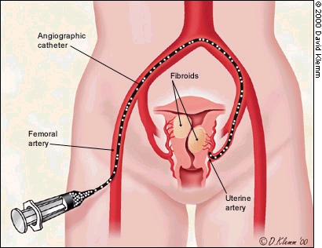
Uterine Artery Embolization

Slide 24
2. Retained placenta
Retained placenta definition as retention of the placenta in utero for more than 30 minutes.
This bleeding may be visible or may manifest only by the increasing size of the uterus.
Ensuring that the bladder is empty may speed the delivery of the placenta and at least aid in the assessment and control of the uterus

Slide 25
A number of trials have evaluated the role of injection into the umbilical cord in the management of retained placenta in women not experiencing significant bleeding. Injections into the cord vein have used normal saline, oxytocin and saline, prostaglandin and saline, and dextran 70.
The studies comparing injection of oxytocin (commonly, 10 IU) and saline (commonly, 20 mL) with expectant management or saline injection alone suggest that this practice indeed reduces the need for manual removal of the placenta. This intervention seems reasonable in stable women with minimal bleeding while preparations for a manual removal are being made.
Manual removal of the placenta is warranted if the above maneuvers have failed to deliver the placenta or if significant bleeding occurs. The bleeding placenta should be removed there there

Slide 26
an elbow-length glove is worn and attention is paid to asepsis. The perineum and vagina must be prepared. The vaginal hand may be immersed in povidone-iodine solution (Proviodine) to facilitate easier entry. The hand is passed into the vagina through the cervix and into the lower segment following the umbilical cord. Care is taken to minimize the profile of the hand as it enters, keeping the thumb and fingers together in the shape of a cone to avoid damage. Control of the uterine fundus with the nonvaginal hand is essential . . Ensure that an oxytocin infusion is running rapidly as the hand is withdrawn in order to encourage strong uterine contraction, and then perform uterine massage. Care must be taken to tease out the membranes. Once uterine contraction is established, examine the placenta and membranes to determine whether further exploration or curettage is necessary. The administration of antibiotics following manual removal is sometimes advocated.

Slide 27
3. Uterine inversion
This condition is very rare. The risk of uterine inversion is increased in abnormalities of placentation, such as accreta, and is more likely with fundal cord insertions and any condition that predisposes patients to uterine atony and prolapse. Cord traction should never occur without countertraction or in the absence of uterine contraction. Leave the placenta attached, and focus management on maternal resuscitation and rapid return of the uterus to the abdominal cavity.
The fingers are formed into a single cone-shaped unit and placed at the most dependent portion of the protruding mass, which represents the inverted uterine fundus. Gentle upward pressure is exerted in the axis of the birth canal with the fingers and thumb together to minimize the risk of uterine perforation. The action has been likened to that of placing the fingers at the toe of an inside-out sock and pushing to make the sock right-side out. Following uterine replacement, vigorous massage and uterotonic administration should undertaken.
Manual removal of the placenta may be performed when the mother's vital signs are stable unless concern exists regarding abnormal placentation. Uterine relaxants, such as nitroglycerin, may be helpful.

Slide 28
4. Placenta accreta
Placenta accreta and its variants are not complications of third-stage management but are most commonly recognized during the third stage. These life-threatening abnormalities of placentation may occur spontaneously; however, they are much more common in situations in which the placenta has implanted over a previously scarred uterus. The routine use and improving capabilities of ultrasound may suggest this diagnosis in the antepartum period, and the diagnosis should be considered in high-risk situations. The possibility of placenta accreta mandates that preparations for the management of severe PPH are in place and, if suggested based on ultrasound findings, that expertise is available to deal with the complications of placenta percreta.

Slide 29
MEDICO-LEGAL PITFALLS
Trials support the use of some form of active management of the third stage of labor. Failing to heed this evidence may result in medicolegal difficulties should PPH and subsequent complications arise.
PPH may occur in any patient, and every clinician should have a clear plan of management. Labor and delivery units should have access to appropriate blood transfusion services, and all necessary medications should be readily available. Timely consultation and intervention must occur, and the speed with which PPH can result in a critically ill patient must be borne in mind.
Women identified at particularly high risk for complications of the third stage must be counseled appropriately and have suitable arrangements made for their care in labor and delivery and in the postpartum period.

Slide 30
References
Philip N. Baker, ed. Obstretics by Ten Teachers, 18th edn
Management of Emergency obstretic Complications, department of Obstretic & Gyna Muhimbili National Hosp 2007
Williams Obstretics

Slide 31
Firm Iv
John Sanyiwa
Nuru J Penza
Pedro ‘Muhas’ Kisali
Maria Mtolera
Innocent Rwiza
Linda Sam
Vangilisasi Msola
Editruda Ngailo
Igembe Nkandala
Anna-Mary Stanslaus
Erasto Rite
Caroline Swai
Latifa Rajab
Shazma Suleiman
Erica Mrema - Chairwoman

Slide 32
THANK YOU FOR YOUR ATTENTION
HISIA

